Slide 1

UNIT 4

Slide 2
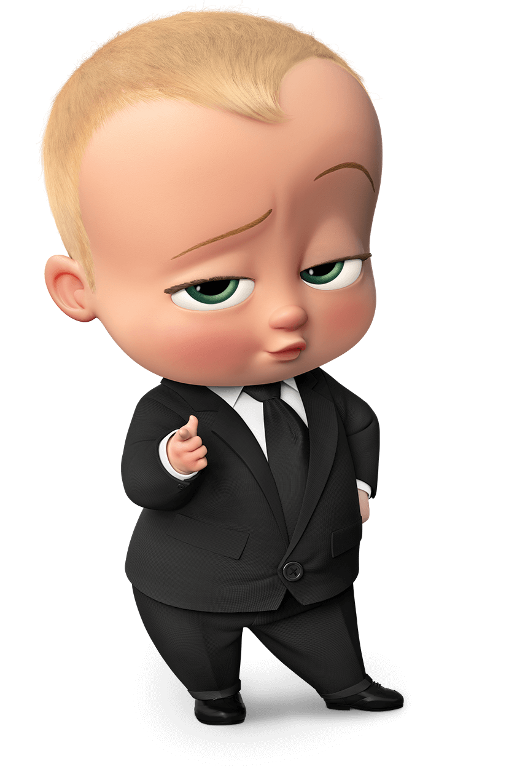
What is Power?
Power is the ability to influence other people. It refers to the capacity to affect the behaviour of the subordinate with the control of resources. It is an exchange relationship that occurs in transactions between an agent and a target.

Slide 3
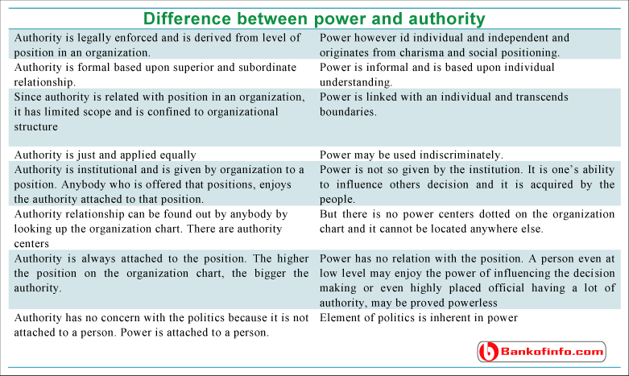
Difference Between Authority & Power

Slide 4

Sources of Power
Legitimate
Expert
Referent
Coercive
Reward

Slide 5

Organizational Politics
Organizational politics are informal, unofficial, and sometimes behind-the-scenes efforts to sell ideas, influence an organization, increase power, or achieve other targeted objectives. Politics has been around for millennia.

Slide 6
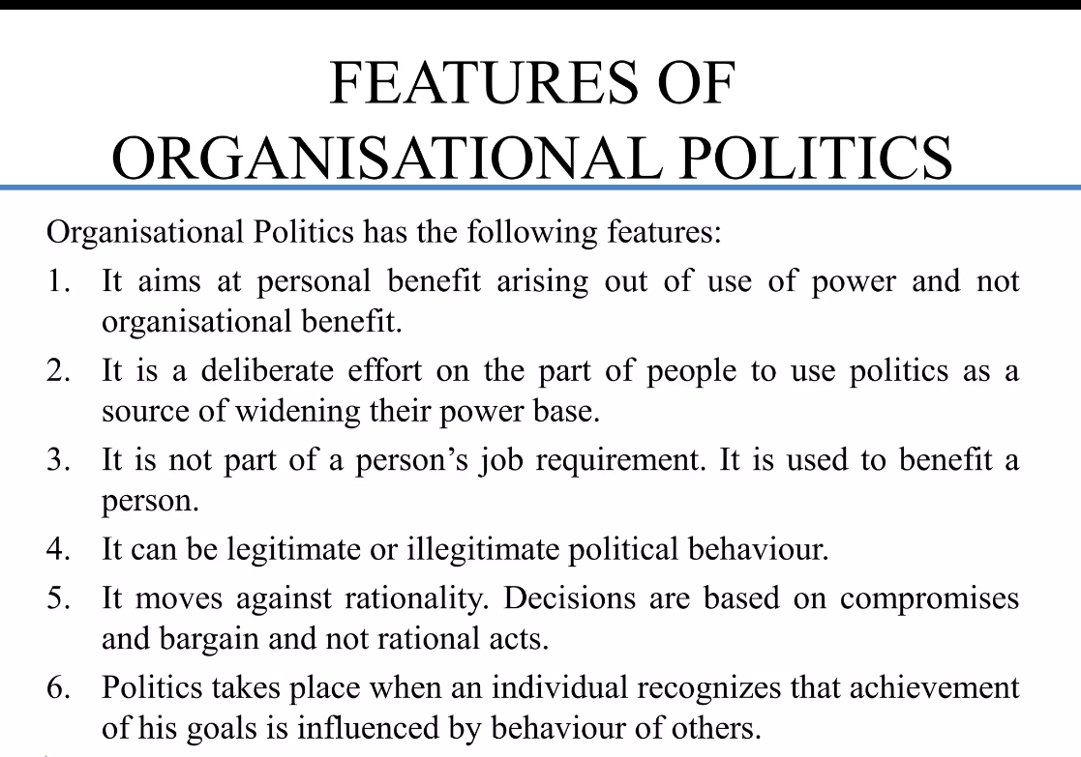

Slide 7
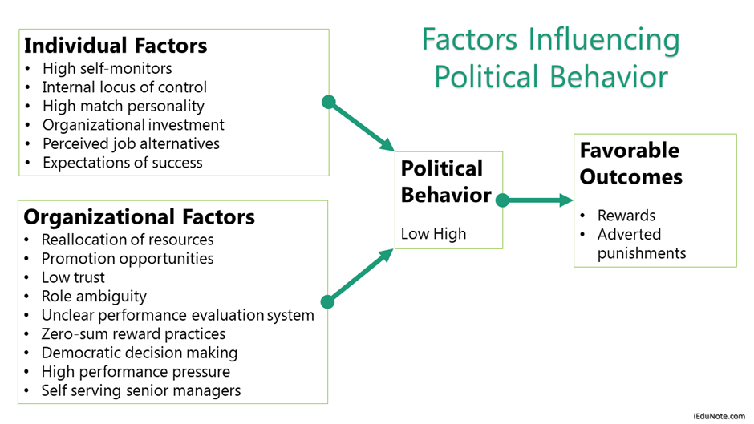

Slide 8

Managing Political Behaviour
Define Job Duties Clearly
Design Jobs Properly
Demonstrate Proper Behaviour
Promote Understanding
Allocate Resources Judiciously

Slide 9

Conflict
“As a disagreement between two or more
individuals or groups, with each individual or group trying to gain acceptance of its views or objective over others.”

Slide 10
VIEWS OF CONFLICT
Traditional View: The belief that all conflicts are harmful and must be avoided
Human Relations View: That belief that conflict is a natural and inevitable outcome in any group
Integrationist View: The belief that conflict is not only a positive force in group but that it is absolutely necessary for a group to perform effectively

Slide 11

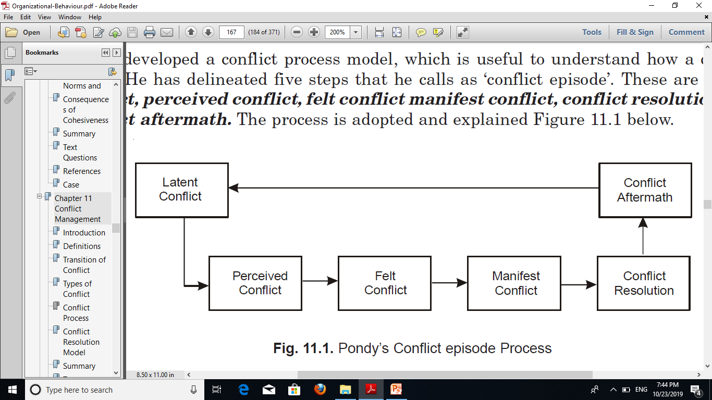
STAGES OF CONFLICT

Slide 12
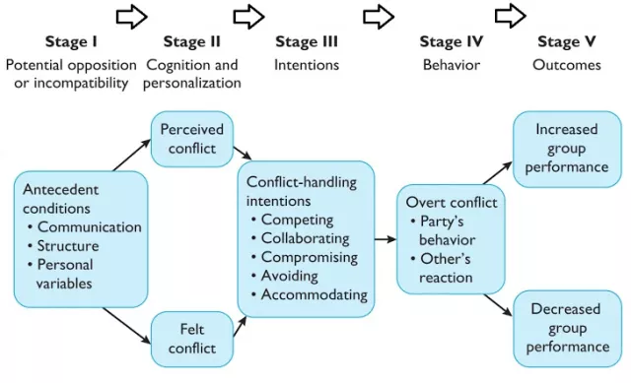
CONFLICT PROCESS

Slide 13
Levels Of Conflict In An Organization
Intrapersonal Conflict
Interpersonal Conflict
Intragroup Conflict
Intergroup Conflict

Slide 14
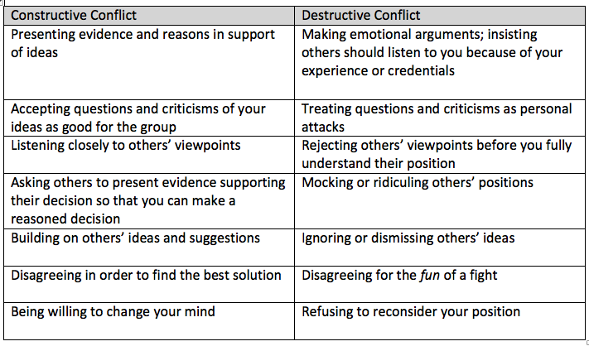
Constructive Vs Destructive

Slide 15
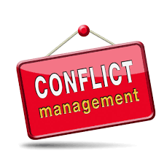
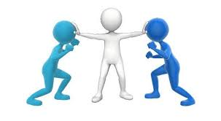
Conflict management is the process of limiting the negative aspects of conflict while increasing the positive aspects of conflict. The aim of conflict management is to enhance learning and group outcomes, including effectiveness or performance in an organizational setting.

Slide 16
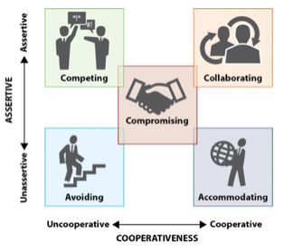
Conflict Continuum
I win, you lose (Competition—A)
I lose or give in (Accommodate—B)
We both get something (Compromise—C)
We both “win”(Collaborate—D)
No winners, no losers (Avoid – E)

Slide 17
Manage Level of Conflict
Follow your values
Interpersonal Conflict
1. Define conflict
2. Put the conflict into text
3. Create options
4. Agree on a solution
Intragroup Conflict
Discuss the conflict as a team
Reach the decision
Intergroup Conflict
Discuss the issue
Closed Meeting
Intrapersonal Conflict
Check your company policy
Write the conflict down
Be conscious of time
Collaborate in small groups
Gather possible solutions

Slide 18
Tips for Managing Conflict
Avoids feelings or perceptions that imply the other person is wrong or needs to change.
Communicates a desire to work together to explore a problem or seek a solution.
Exhibits behavior that is spontaneous and destruction-free.
Identifies with another team member’s problems, shares feelings, and accepts the team member’s reaction.
Treats other team members with respect and trust.
Investigates issues rather than taking sides on them.

Slide 19
Strategies For Fostering Constructive Conflict
Call out the unique value each individual team member brings to the table
  Team members are more likely to support one another and less likely to compete if their “needs for uniqueness” are met.
Find appropriate ways to use humor
  Having fun and laughing creates a safe psychological space; people don’t get defensive if they are not feeling threatened. This can minimize the chances people will take questioning personally.
Identify, and continuously reinforce, a shared group goal
  Connecting over a shared, higher-level goal helps individual members identify with the team as they all have stakes in a shared fate.
Balance the power distribution
  Rather than having one assigned leader or final decision-maker, it can be beneficial for the team to share decision-making power.

